Slide 1
BUY PPT
Ref. Website – anatomyandme.com

Slide 2
MUSCLES OF FACIAL EXPRESSION
Dr. ,
PROFESSOR, DEPT. OF ANATOMY.

Slide 3
COMPETENCIES : AN 28.1, AN 28.3
SPECIFIC LEARNING OBJECTIVES:
At the end of the class the student must be able to understand the following
What are muscles of facial expression and why
Tophography of facial muscles
Nerve supply and actions
Clinical significance.

Slide 4
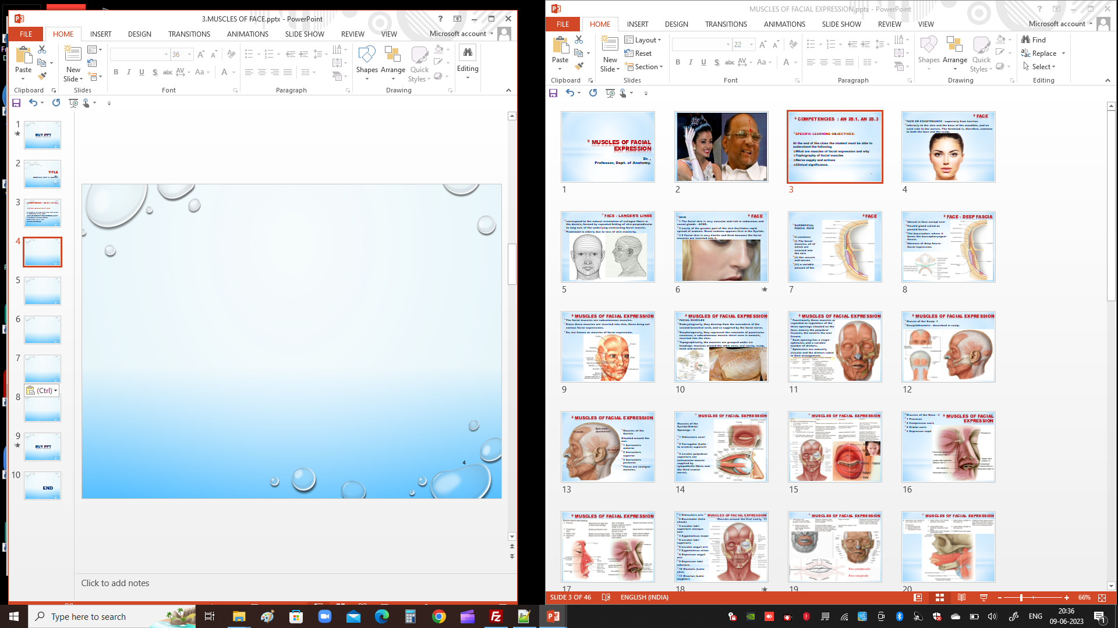

Slide 5
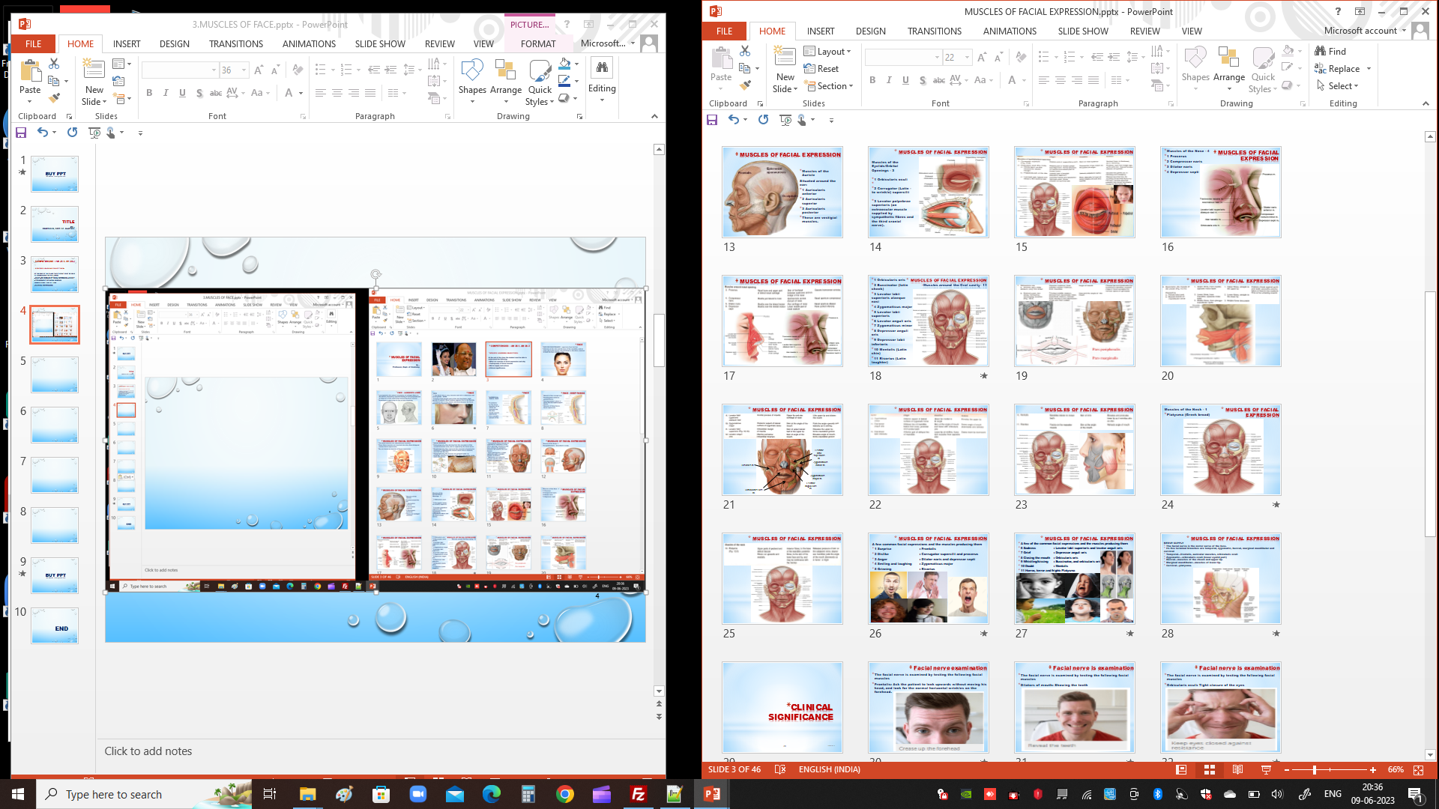

Slide 6
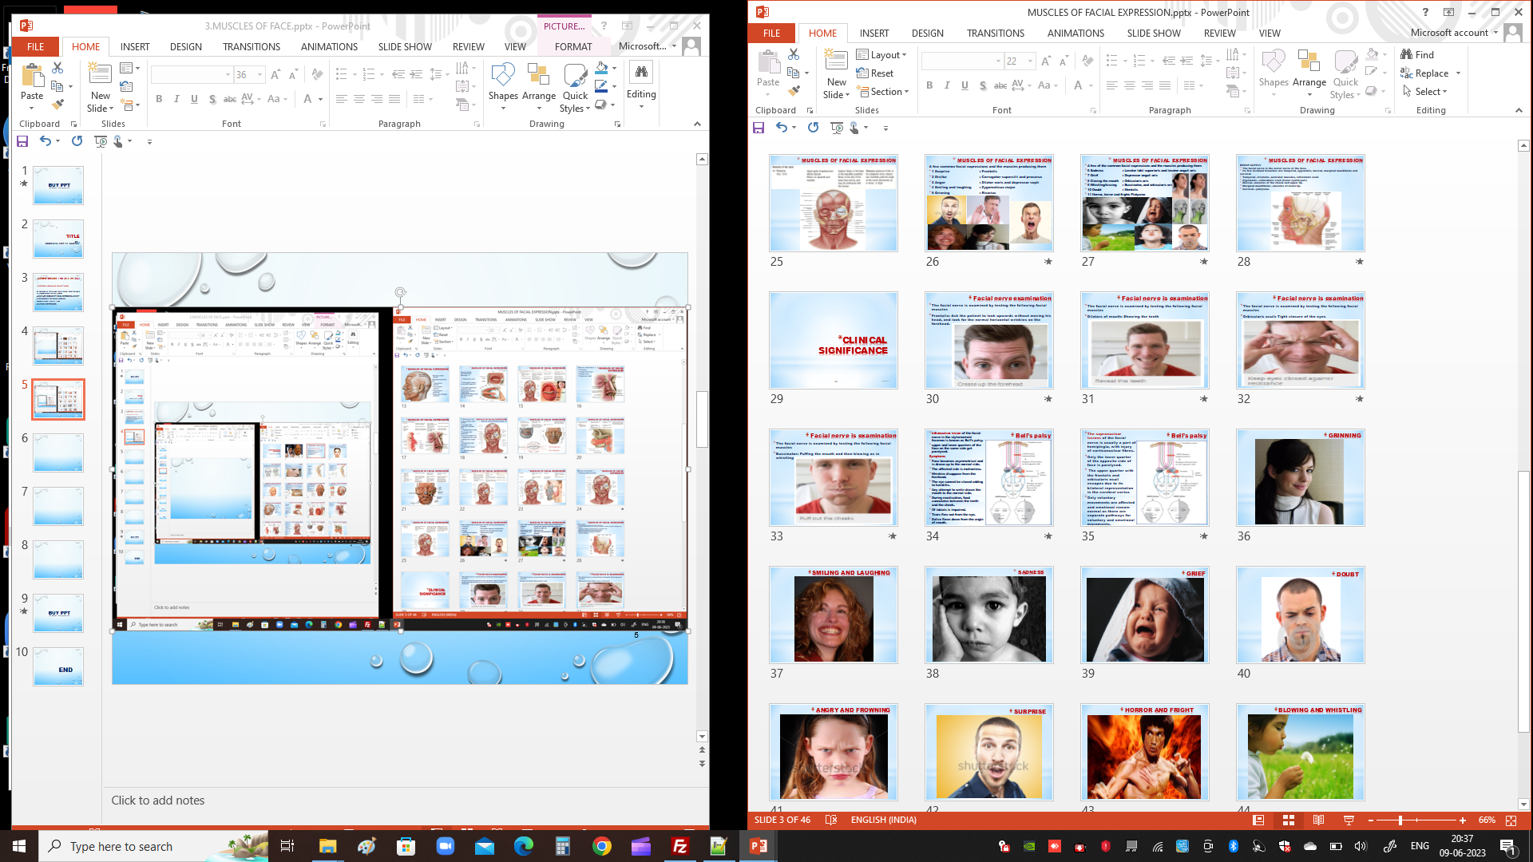

Slide 7
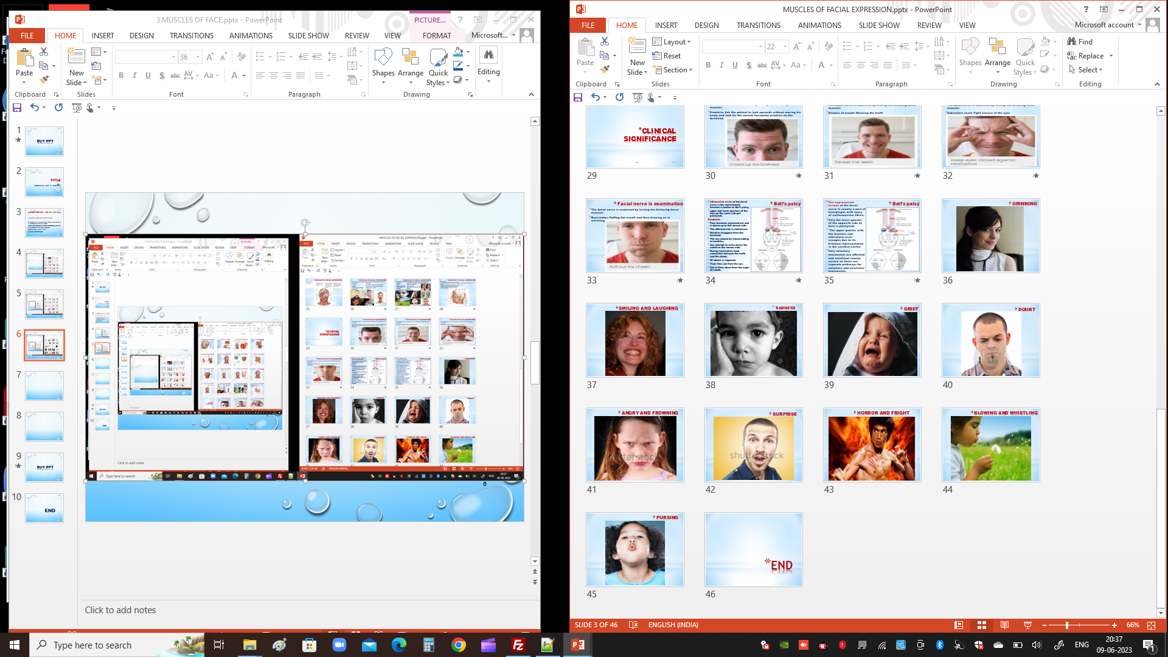

Slide 8
BUY PPT
Ref. Website – anatomyandme.com

Slide 9
END

